Slide 1

Electricity price
Forecasting
Prepared by :
Hajar BELAYD
Youssef BEN ALLAL
Youssef LAZREK
Supervised by :
Maryam GUESSOUS
Notes:
Photo by Jared Rice on Unsplash

Slide 2
Summary
VI.Summary
V.Model implementation
IV.feature engineering
IV.Visualization
III. Data Cleaning
II. Data description
I.Introduction

Slide 3
1
Introduction
Forecasting hourly electricity price
Short term time serie problem
Adapting supervised learning models to a time series problem

Slide 4
2
Data Description
Time
dt_iso
Total load
Total load actual
City name
City_name
Weather description
Weather_description
Temperature
Temp_min
Temp_max
Temparture
Weather data
Weather id
weather_id
Pressure
pressure
Energy data
Snow
Snow_3h
Humidity
humidity
Rain
rain_1h
Rain_3h
Clouds
Cloudiness rate
Wind
Wind_speed
Wind_degree
Source : Open weather API

Slide 5
2
Data Description
time
time
Weather data
Energy data
Price
Price actual
Price day ahead
Generation
Generation biomass
Generation fossil brown coal/lignite
Generation fossil gas
Generation fossil coal-derived gas
Generation fossil hard coal
Generation fossil oil
Generation fossil oil shale
Generation fossil peat
Generation geothermal
Generation hydro pumped storage consumption
Generation hydro run-of-river and poundage
Generation hydro water reservoir
Generation marine
Generation nuclear
Generation other
Generation other renewblae
Generation waste
Generation wind offshore
Generation solar
Total load
Total load actual
Source : entsoe

Slide 6
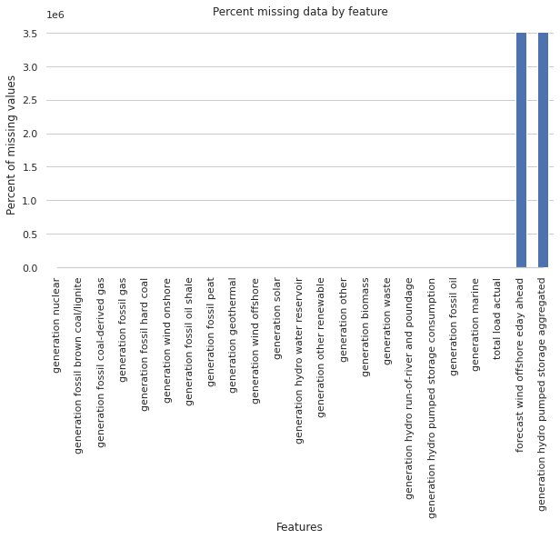
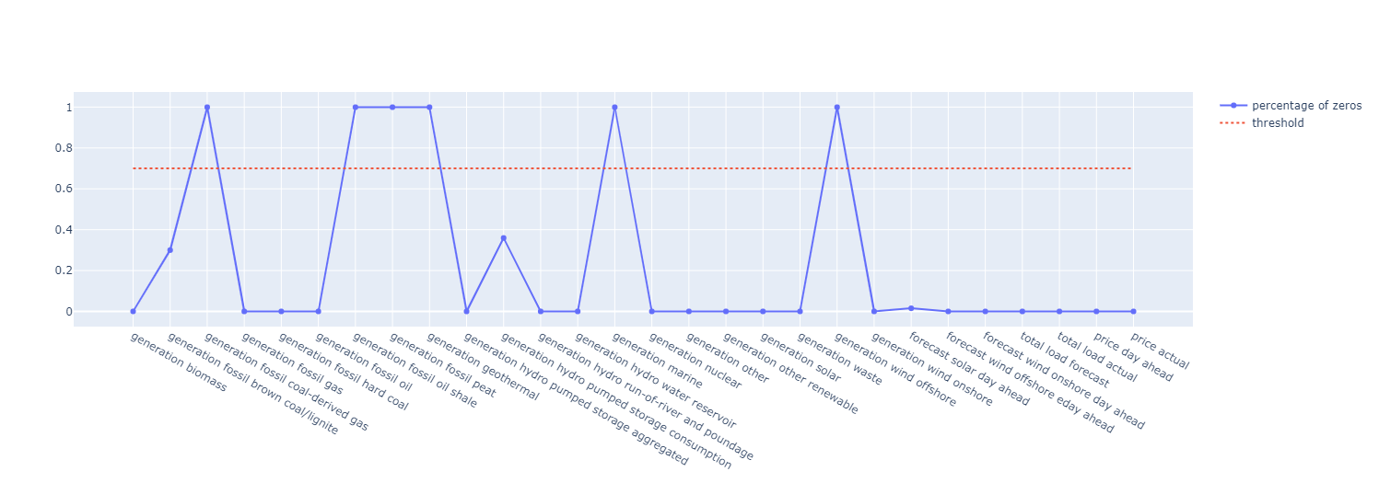
3
Data cleaning
Handling missing values and zero values:
Drop Forecast wind offshore
Drop Generation hydro pump storage
Feature | NAN + Zero rate
Generation hydro pump storage | 36%
Generation fossil brown coal lignite | 30%
Total load actual | 0,1%
Cleaning energy data
Each of the other columns remaining have 0,1% of NAN values.
Cleaning weather data
Drop Some fossil generations – geothermal generations – wind offshore
Merging the data

Slide 7
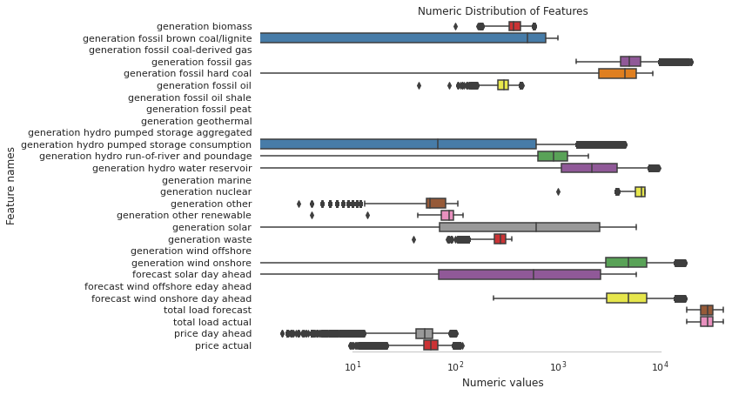
3
Data cleaning
Check the features distribution through boxplot:
Sort the features distribution using skewness coefficent:
Cleaning energy data
Cleaning weather data
Merging the data
Feature | skewness
Forecast solar day ahead | 0.98
Forecast wind onshore day ahead | 0.80
Price actual | -0.32

Slide 8
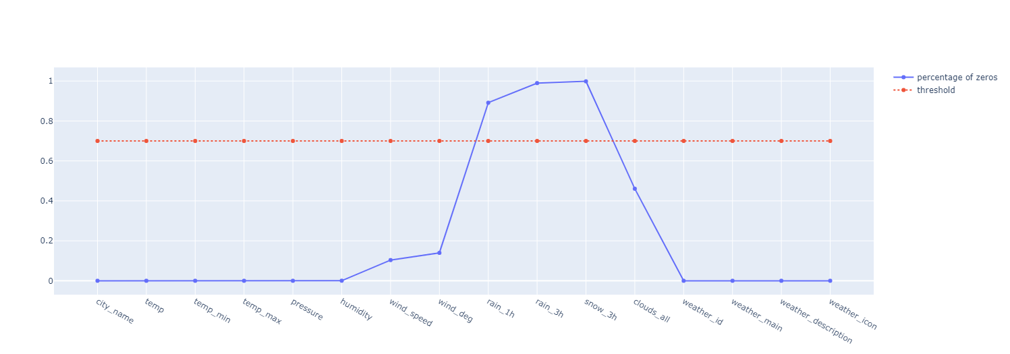
3
Data cleaning
Dropping duplicate rows following time and city_name
Handling zero values:
Sort the features distribution using skewness coefficent:
Snow_3h / rain_3h will be removed
Cleaning energy data
Cleaning weather data
Merging the data
Feature | Skewness
Pressure | 150.86
Wind_speed | 3.17
Rain_1h | 15.89

Slide 9
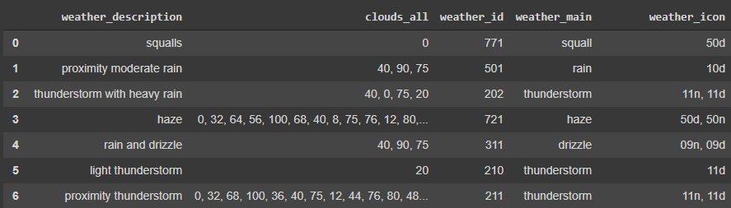
3
Data cleaning
We Remove the obvious irregularities appearing in pressure and wind_speed, this following the maximum and minimum pressures reached in Spain during the period of study.
We fill the irregularities using interpolation.
Handling categorical features : (weather_id, weather_main, weather_icon, weather_description)
Drop columns with an insignificant hourly range (‘temp_min’, ‘temp_max’).
Cleaning energy data
Cleaning weather data
Merging the data
Drop ‘weather_id’, ‘weather_main’ , ‘weather_icon’.

Slide 10
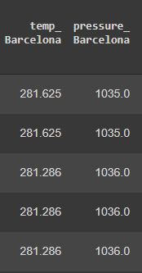
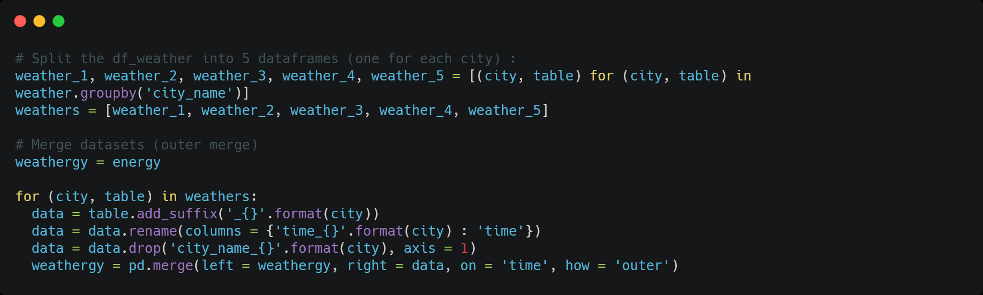
4
Data cleaning
Split the weather data into 5 data frames ,one for each city (Madrid, Valencia, Bilbao, Barcelona, Seville.)
Rename weather data features variable into features{city}.
Merging the energy data frame with the five weather data frames according to the time index.
Fill the remaining missing values with interpolation (each feature has a low amount of NAN (0,1%))
Encode the categorical variable (weather_description using label encoding)
Code implementation and sample of final data :
Cleaning weather data
Cleaning energy data
Merging the data

Slide 11
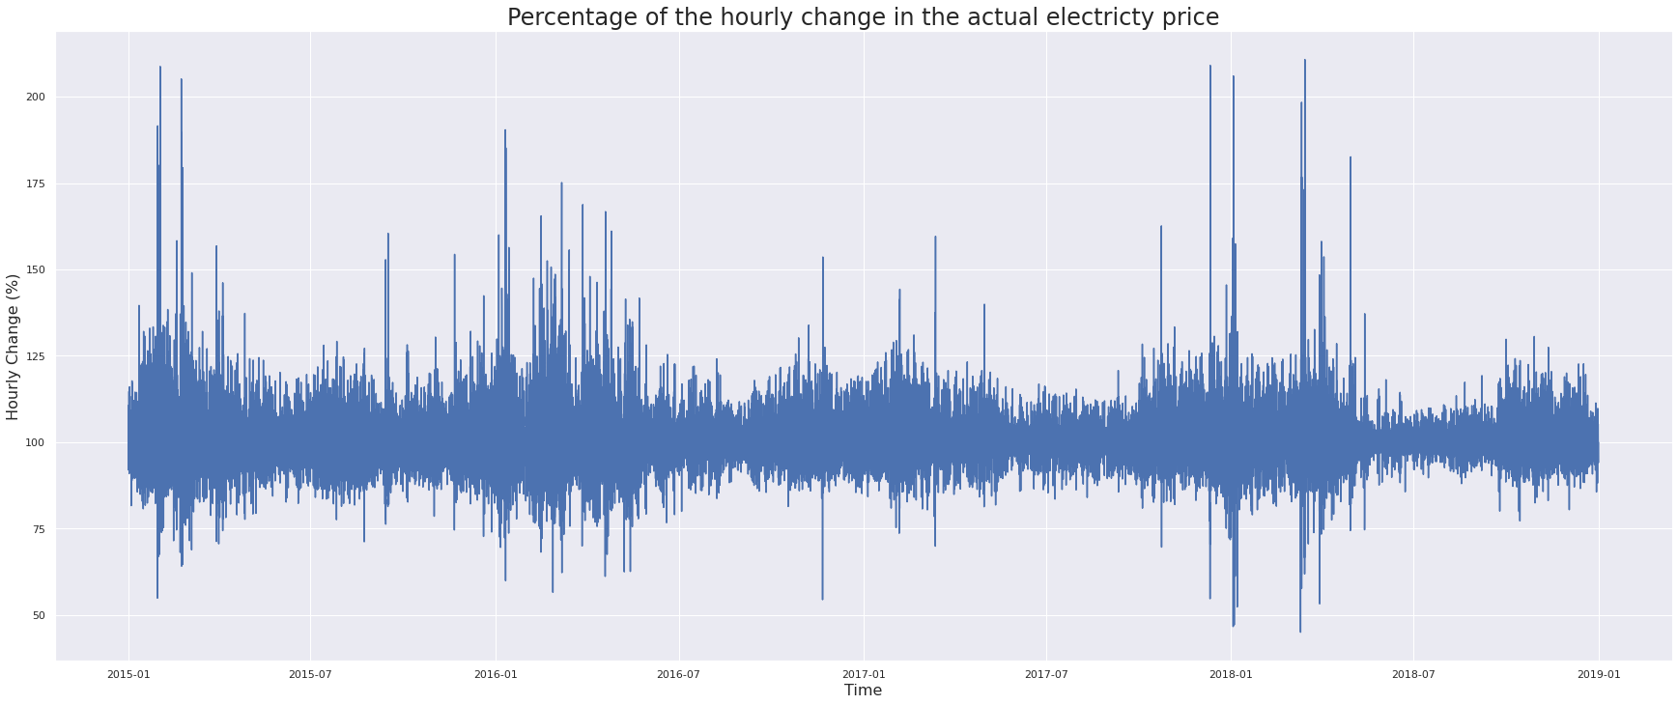
5
Visualization
Hourly price variations
Trends visualizations
Price Common range(-25% (actual price * 0.75) , +25% (actual price * 1.25))
Useful visualizations

Slide 12
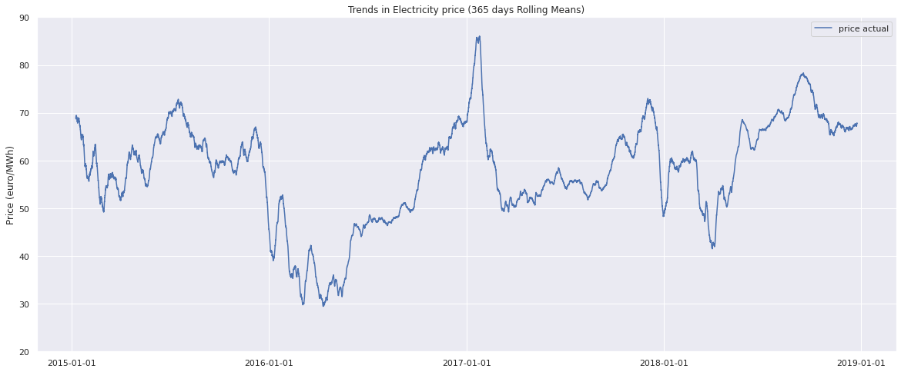
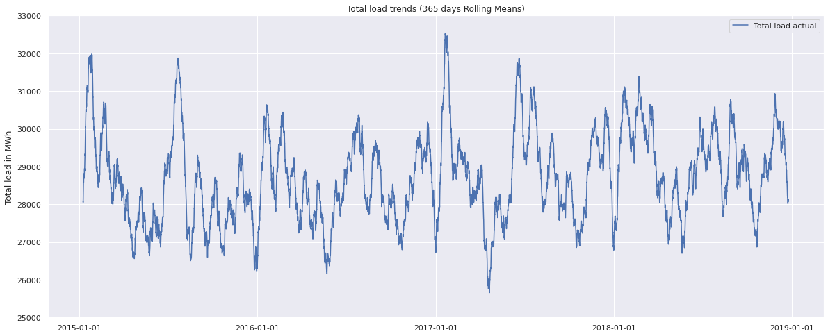
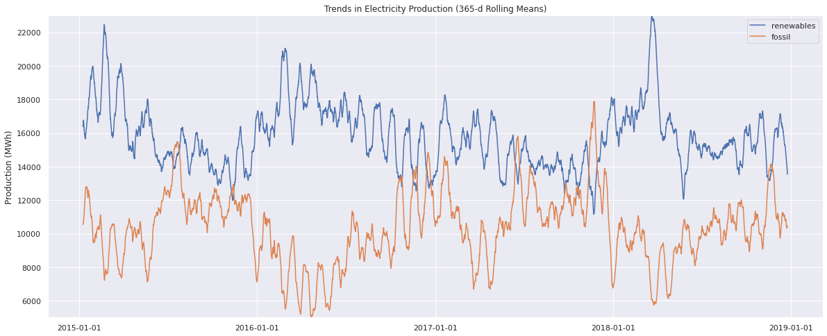
5
Visualization
The mean price of the Spanish wholesale electricity market in January 2016 dropped by 13 €/MWh compared to 2015
While the electricity demand in Spain in 2016 was 0.5% higher than that of 2015
Hourly price variations
Trends visualizations
Useful visualizations
This decrease is mainly due to the increase in electricity production with less expensive technologies such as hydro generation, wind and nuclear as well as the decrease in fossil generation

Slide 13
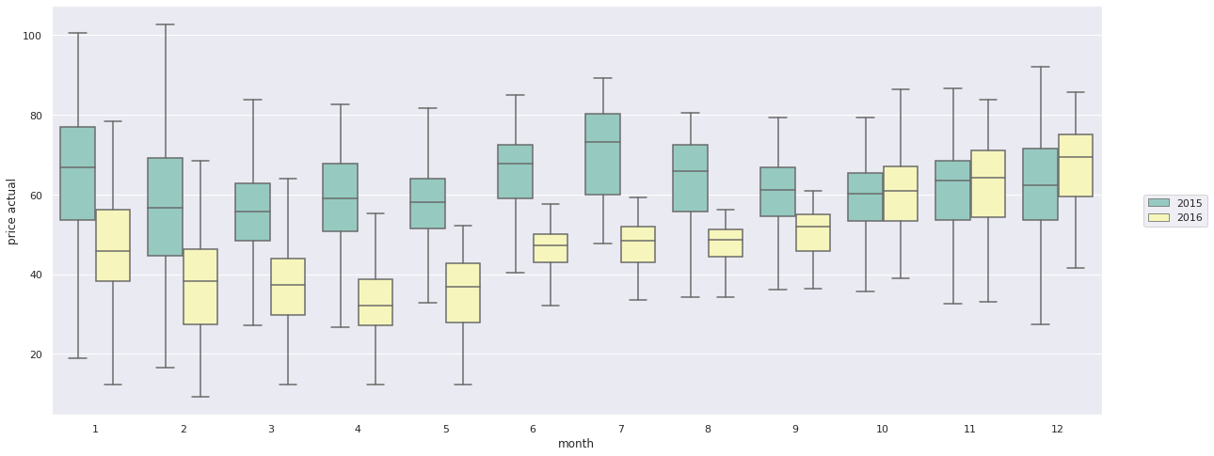
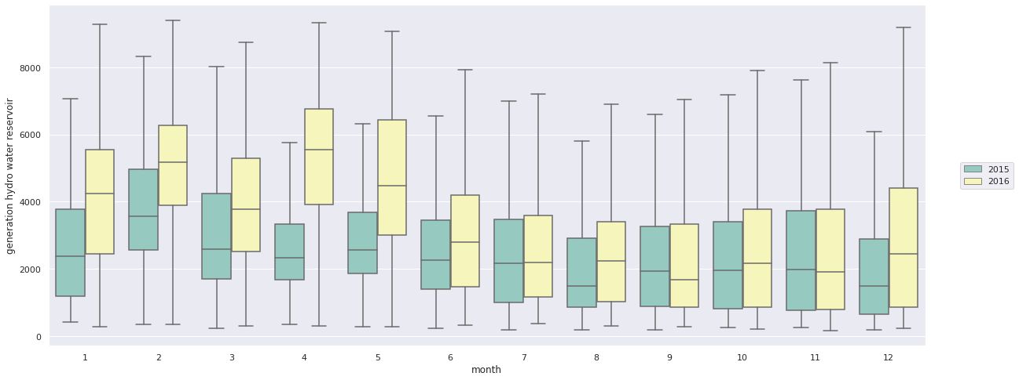
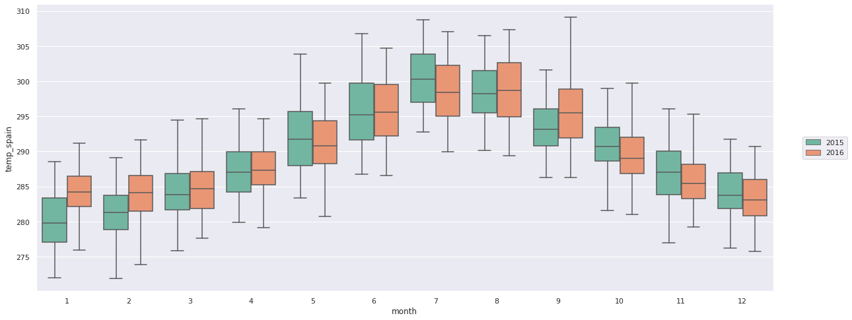
5
Visualization
Hourly price variations
Trends visualizations
Useful visualizations

Slide 14
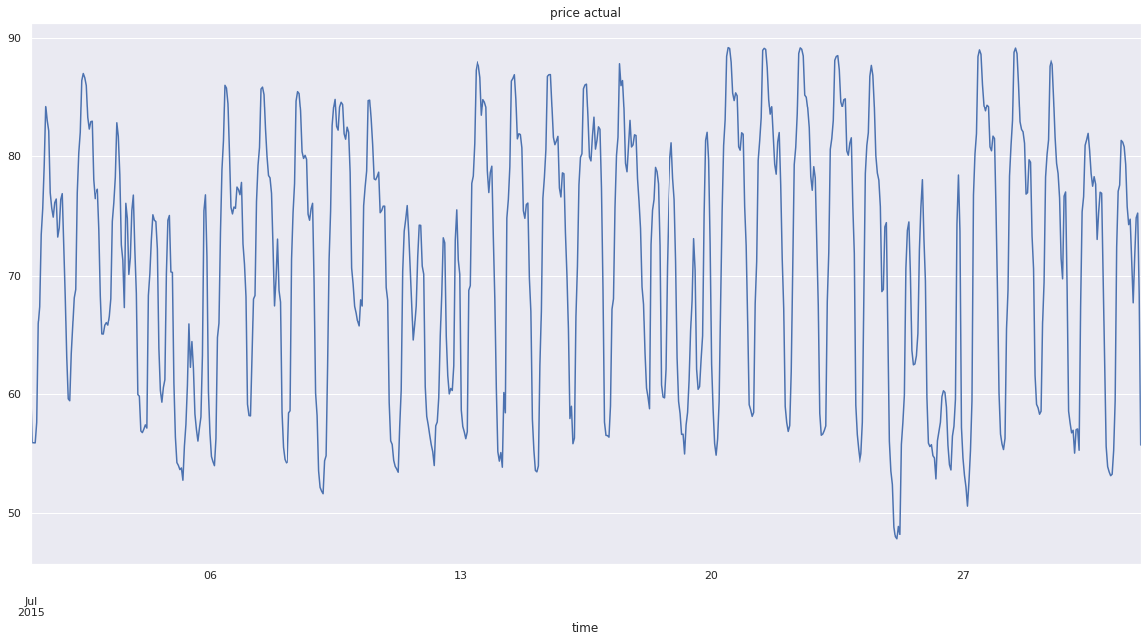
5
Visualization
Electricity price variation monthly zoom – July 2015
Hourly price variations
Trends visualizations
Useful visualizations

Slide 15
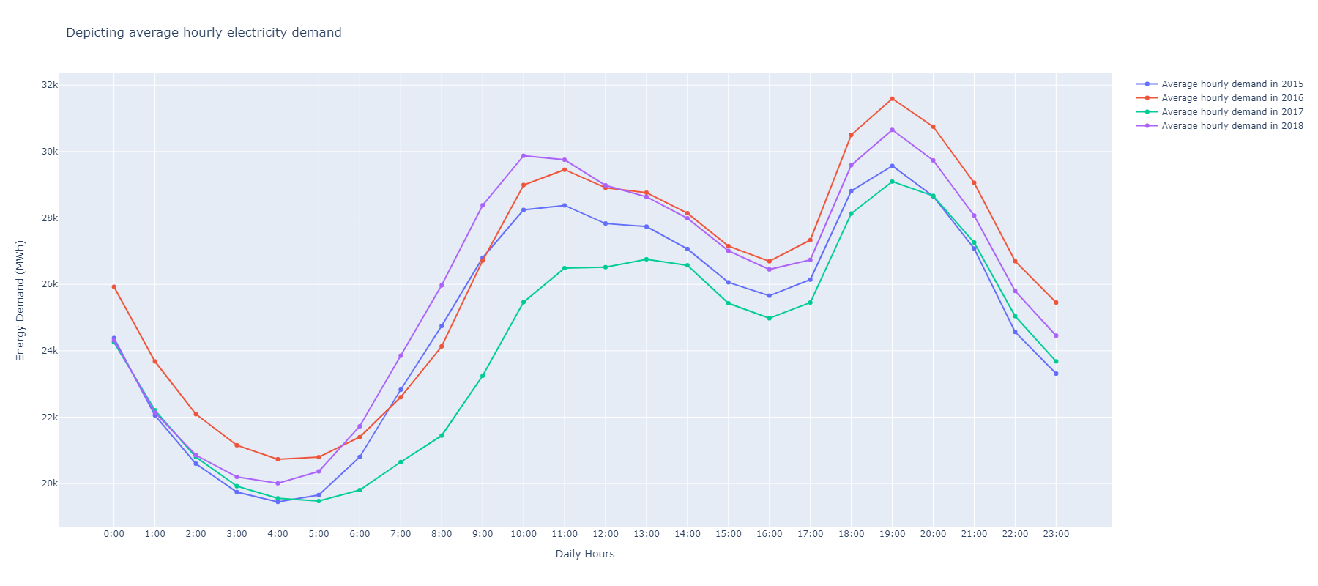
5
Visualization
Average hourly electricity demand
Hourly price variations
Trends visualizations
Useful visualizations

Slide 16
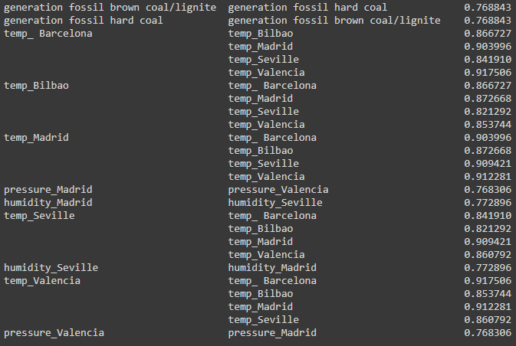
6
Feature engineering
Merging intercorrelated features (correlation > 0,7)
intercorrelation
Correlation with price
Create a column untitled 'generation fossil’ representing the sum of 'generation fossil brown coal /lignite' and 'generation fossil hard coal’
Create a column untitled 'temp_spain' representing the mean of all the city temperatures.
Merging 'pressure_Madrid’ and 'pressure_Valencia' by replacing their columns with a brand
new one containing their mean untitled 'pressure_Madrid_Valencia'
Merging 'humidity_Madrid' and 'humidity_Seville' by replacing their columns with a brand new one
containing their mean untitled 'humidity_Madrid_Seville’.

Slide 17
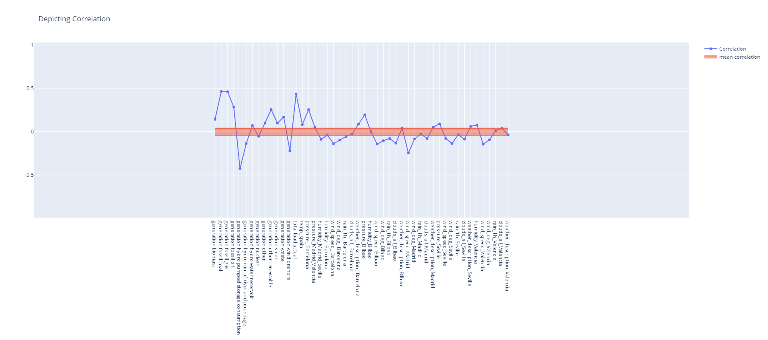
6
Feature engineering
Visualize correlation with the price
intercorrelation
Correlation with price
Results
Eliminating features with a treshhold of 0.04 .

Slide 18
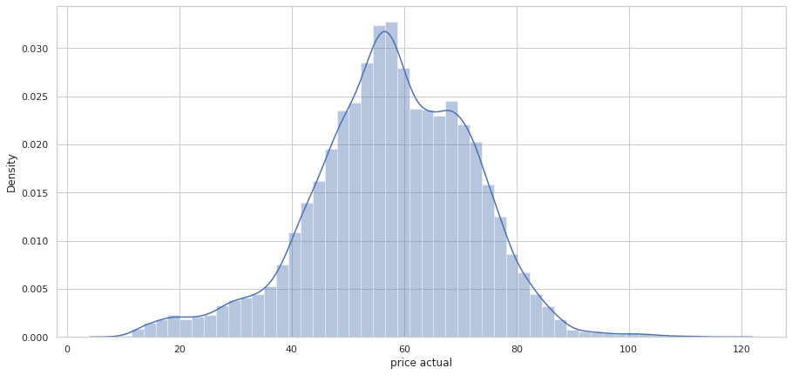
7
Distribution & stationarity test
Visualize the time distribution plot
Skewness : -0.323749
Kurtosis : 0.469561
Price distribution
Stationarity test
Observation.
The price distribution is nearly a normal distribution.
Conclusion.
The price function transformation is not necessary in this case.

Slide 19

7
Distribution & stationarity test
Introduction to Unit root tests
The Dickey fuller tests contains two steps. 1. H0 : Test if the series is stationary 2. H1 : If the series is not stationary, test what kind of non-stationarity is present
Random walk process formula : $Y\left(t\right)−Y\left(t−1\right)= Ω.Y\left(t−1\right)+e(t)$
H0 : $Ω$ = 0
H1 : $Ω$ = 1
Stationarity test
Price distribution

Slide 20
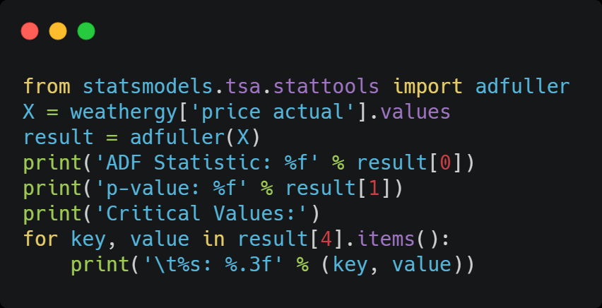
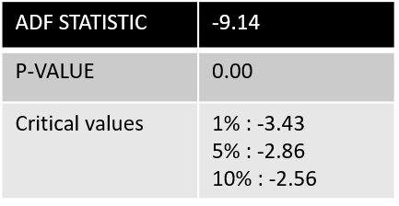
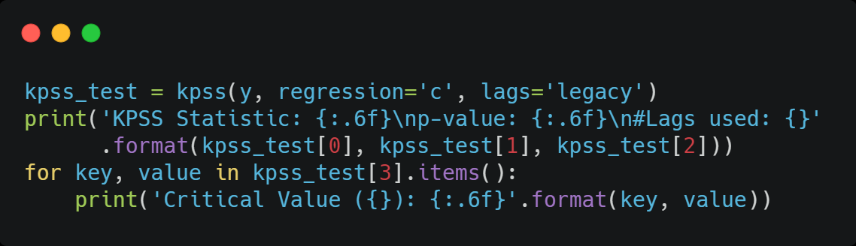
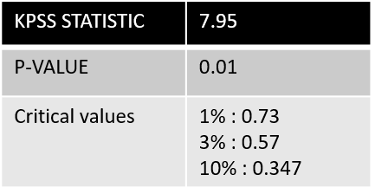
7
Distribution & stationarity test
Ad fuller test implementation :
Price distribution
KPSS test implementation :
Stationarity test
Conclusion.
Both tests concluded that the electricity price time series is stationary.

Slide 21
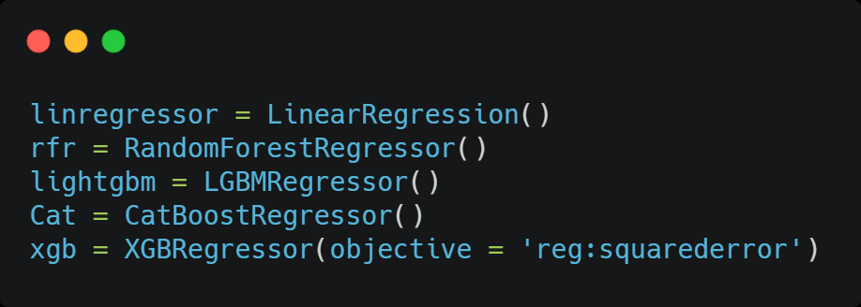
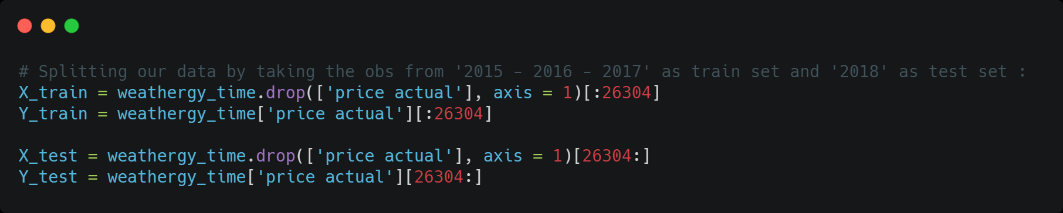
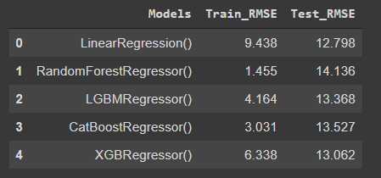
9
Models
First implementation
Multiple train test splits
Walk Forward Validation
Identifying outliers
Hyperparameters tuning using Bayesian Optimization
Blending

Slide 22
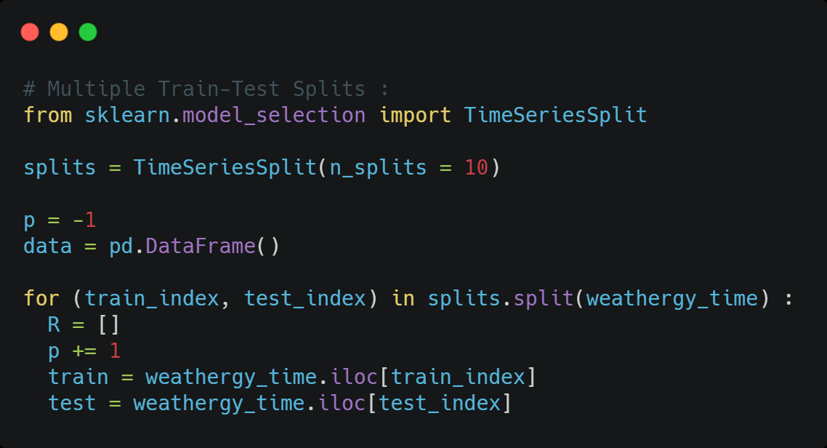
9
Models
Test size remains the same
Train size increases after each split
First implementation
Multiple train test splits
Walk Forward Validation
Identifying outliers
We divided our data into 10 splits
Hyperparameters tuning using Bayesian Optimization
Blending

Slide 23
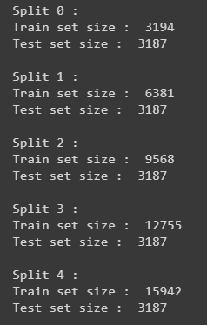
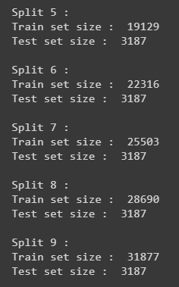
9
Models
Multiple train test splits
Split 1
Train set
Split 0
Test set
Train set
Test set
0
3,194
6,381
9,568
35,064
Size :
3,194
3,187
3,187

Slide 24
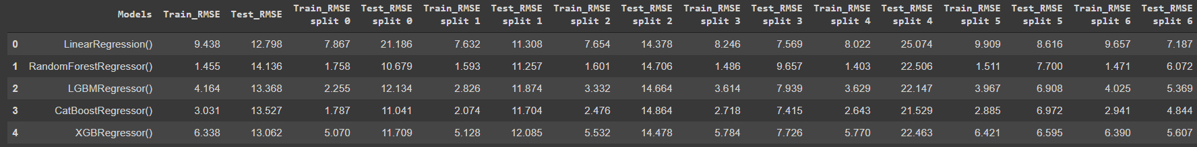
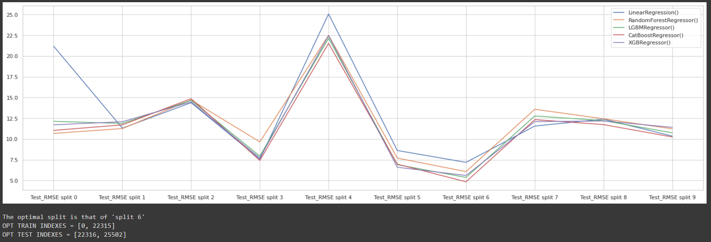
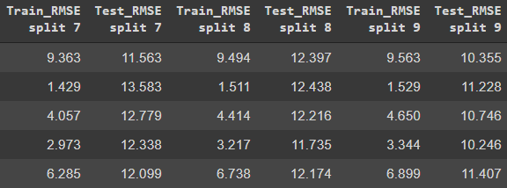
9
Models

Slide 25
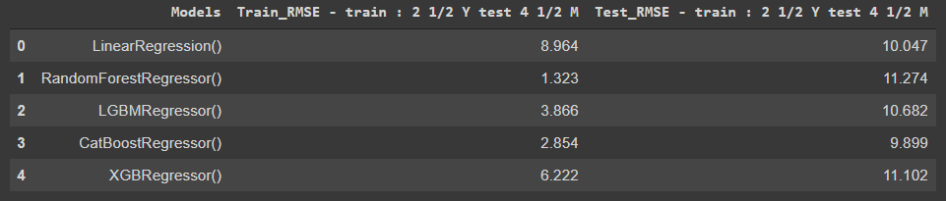
9
Models
Let's now try to predict the price in the last 3187 hours of 2018 (that's approximately the last 4 months and a half of 2018) using the previous 22315 hours

Slide 26
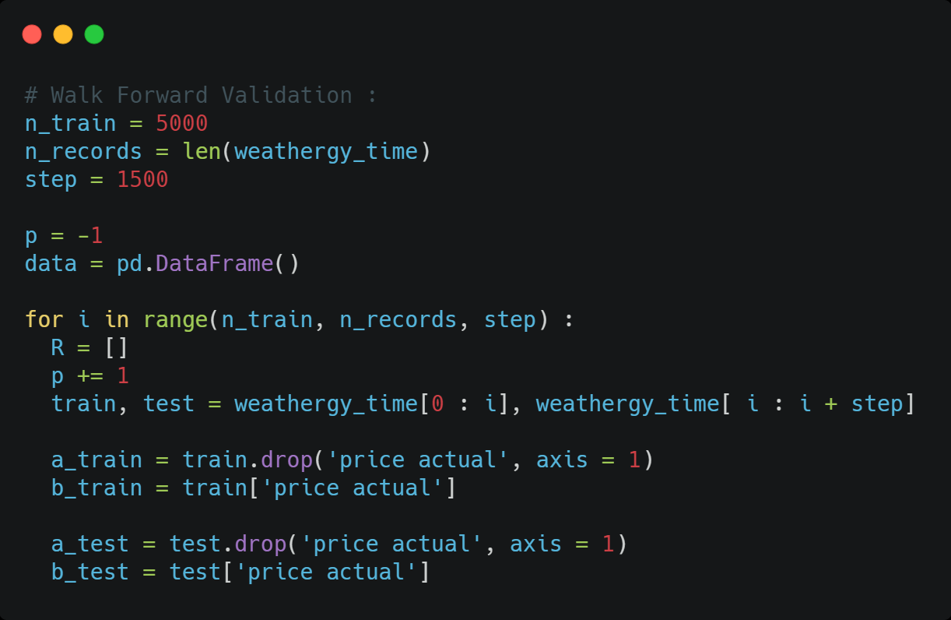
9
Models
First implementation
Multiple train test splits
Walk Forward Validation
Identifying outliers
Hyperparameters tuning using Bayesian Optimization
Blending

Slide 27
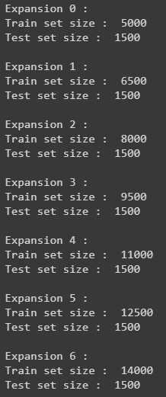
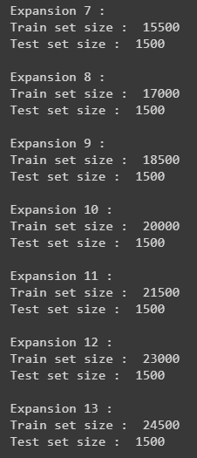
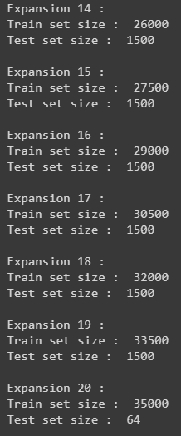
9
Models
Walk Forward validation
Expansion 1
Expansion 0
Test set
Train set
Train set
Test set
0
5,000
6,500
8,000
35,064
Size :
5,000
1,500
1,500

Slide 28
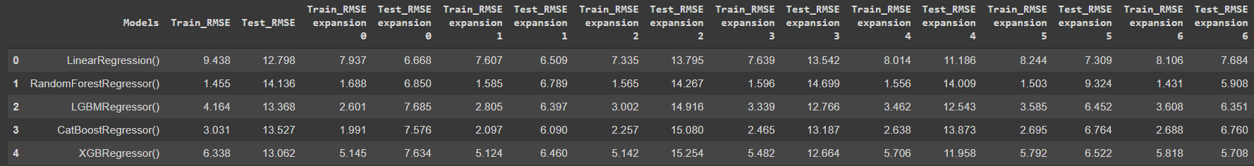
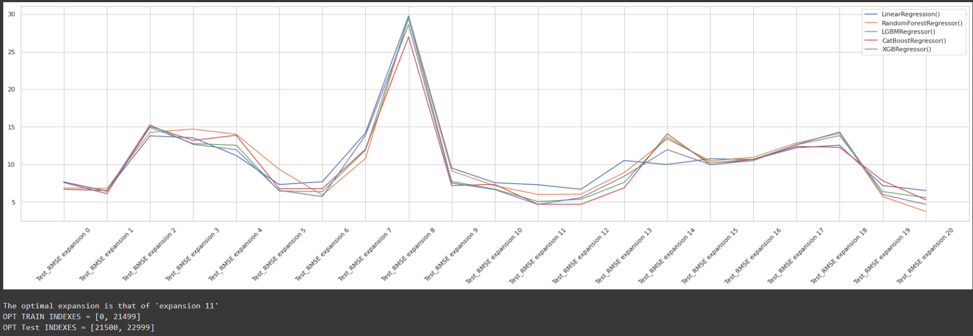
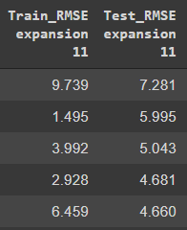
9
Models

Slide 29
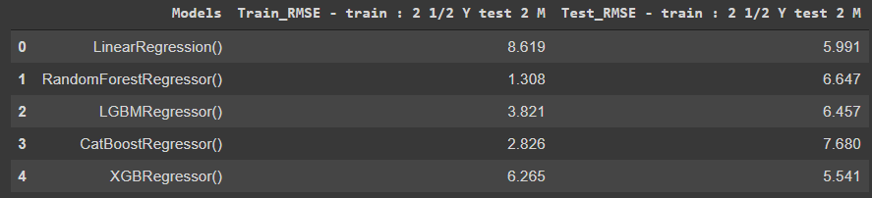
9
Models
Let's now try to predict the price in the last 1500 hours of 2018 (that's approximately the last 2 months of 2018) using the previous 21500 hours
In the rest of this split mehod we will use the train and test sets obtained during Walk Forward validation

Slide 30
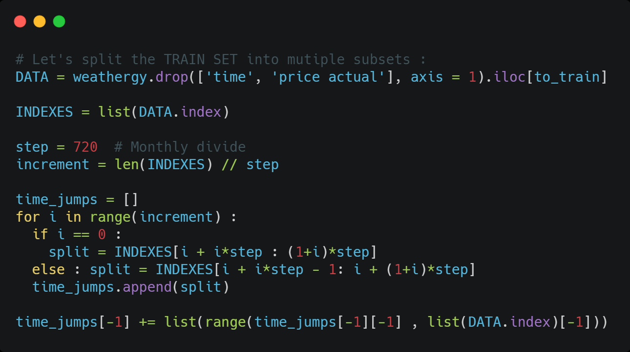
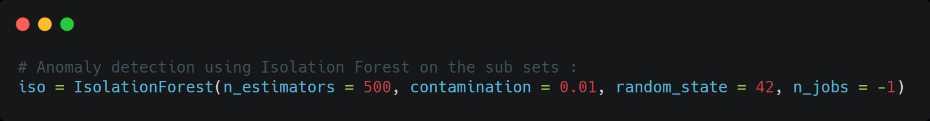
10
Models
a. Isolation forest
Isolation Forest detect anomalies in the data set that is to say an observation or event that deviates so much from other events.
Isolation Forest is a method that thrives on subsets of the original data because it makes the task of finding the anomalies easier for the algorithm.
First implementation
Multiple train test splits
Walk Forward Validation
Identifying outliers
Hyperparameters tuning using Bayesian Optimization
Blending

Slide 31
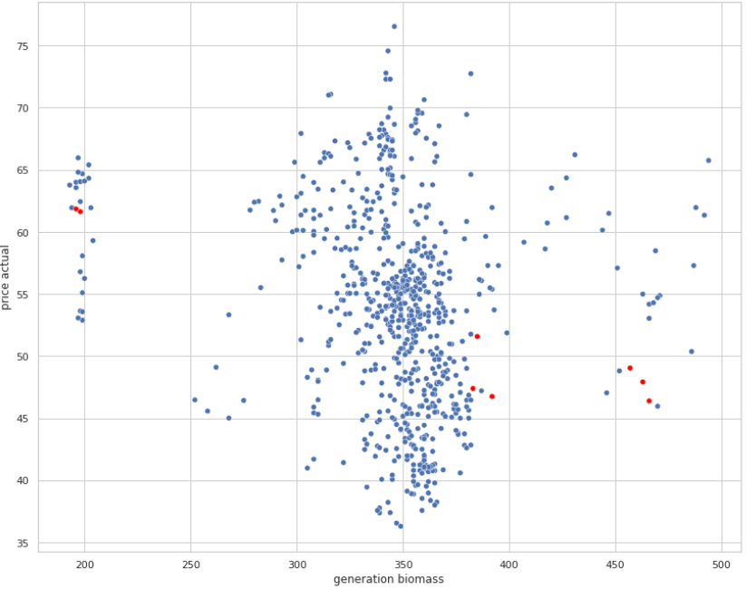
9
Models
Visualize outliers in a random Month
238 outliers identified

Slide 32
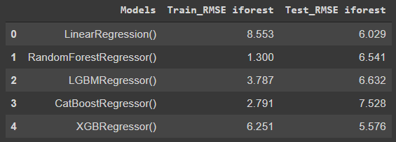
9
Models
Let's remove the outliers and fit our model to the refined data

Slide 33
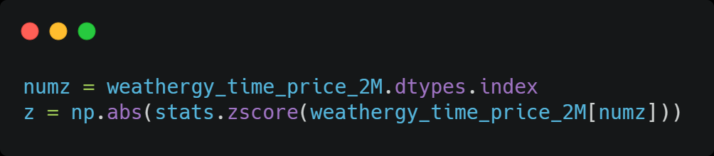
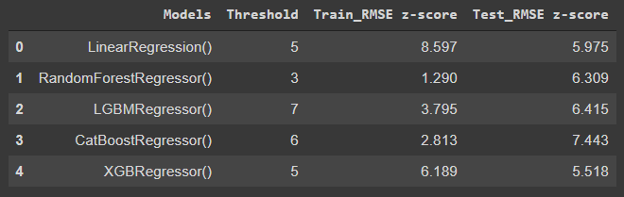
9
Models
b. Extracting outliers using z-score
First implementation
Multiple train test splits
Number of outliers identified using z-score with a threshold greater than 3 is 7430
Walk Forward Validation
Determine the optimal number of outliers to remove in order to minimize RMSE of each model
Identifying outliers
Hyperparameters tuning using Bayesian Optimization
Blending

Slide 34
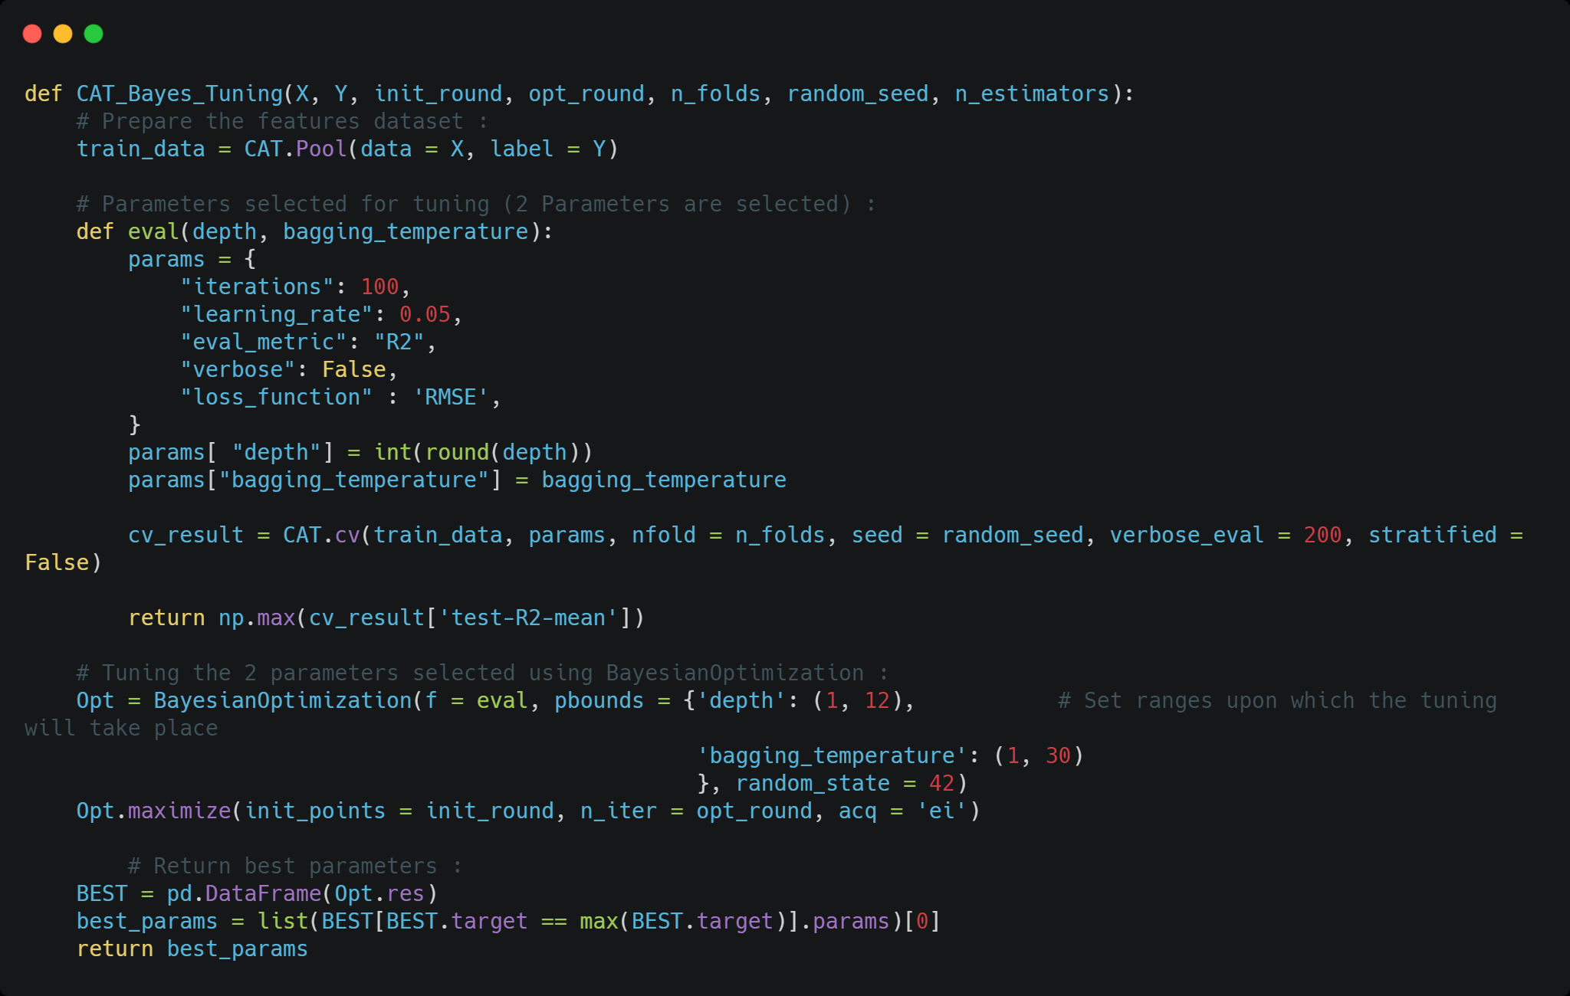
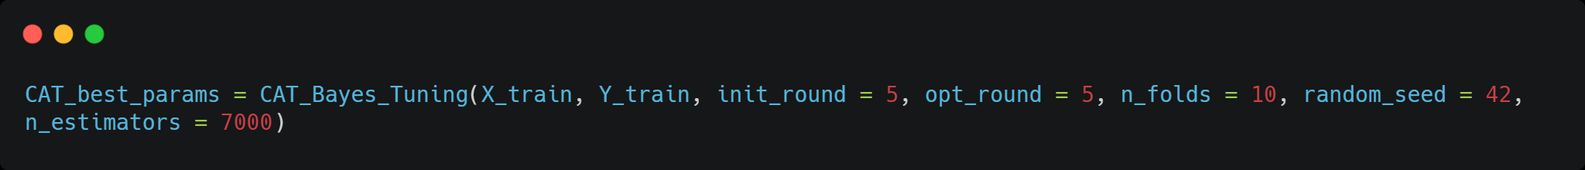
9
Models
Applied to CatBoostRegressor
First implementation
Multiple train test splits
Walk Forward Validation
Identifying outliers
Hyperparameters tuning using Bayesian Optimization
Blending

Slide 35
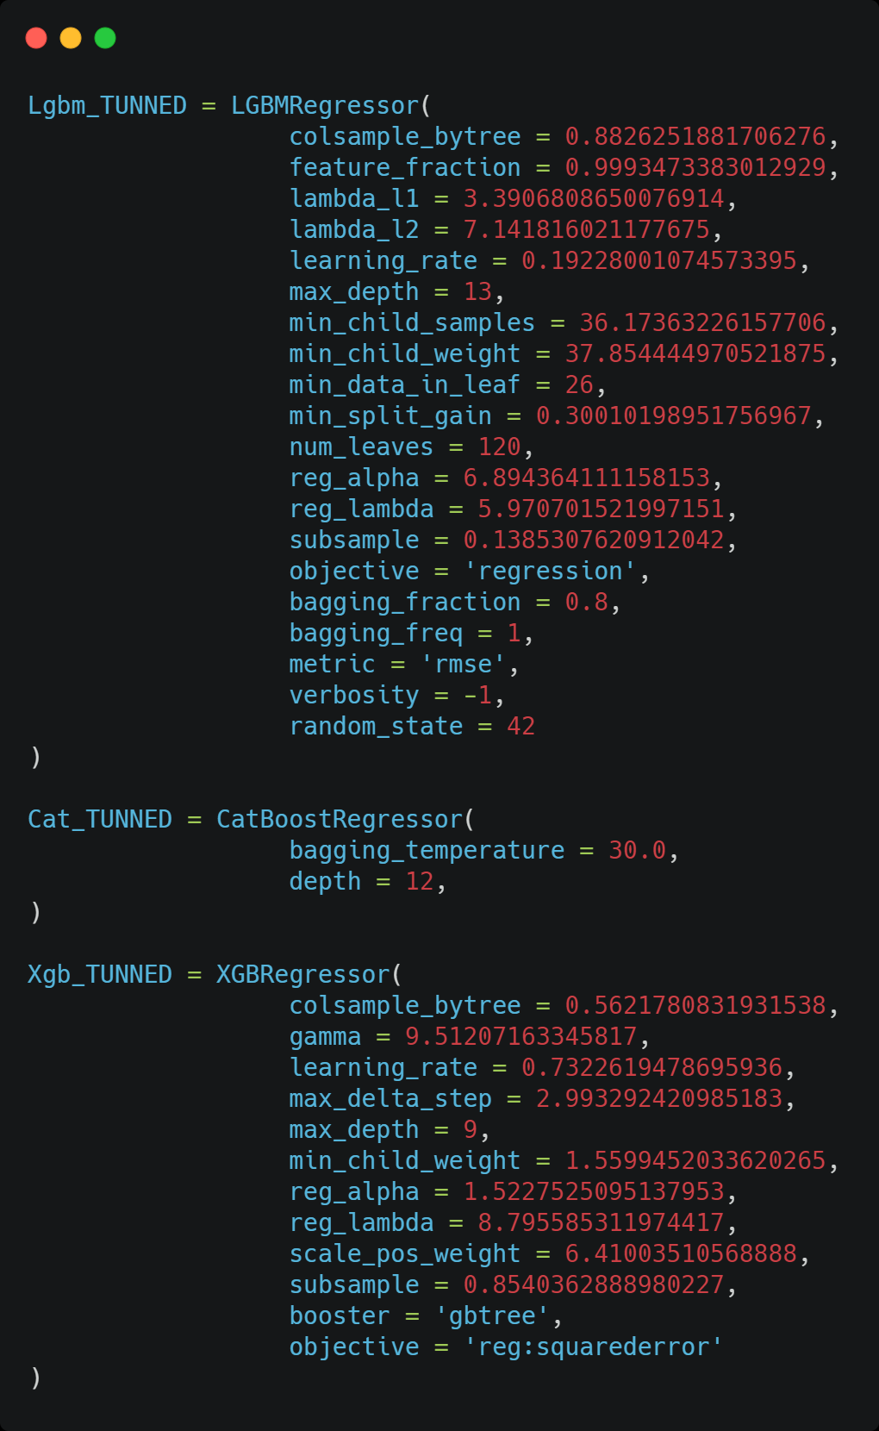


9
Models
Hyperparameters tuning using Bayesian Optimization
Fitting the 3 latest models (Lgbm_TUNNED, Cat_TUNNED, Xgb_TUNNED)

Slide 36

9
Models
Removing outliers from the train data using z-score method

Slide 37


17
Models
Combining the prediction of our two most prominent models :
XGBRegressor() AND CatBoostRegressor(TUNNED)
First implementation
Multiple train test splits
Walk Forward Validation
Identifying outliers
Hyperparameters tuning using Bayesian Optimization
Blending

Slide 38

10
Partial Summary

Slide 39
17
Model projection
Goal: Adapt the time series data to supervised learning algorithms
Introducing the concept
History size choice
Code implementation
Consider the previous (historical values) of each feature to predict the hourly electricity price
Sample of the final data
Results
Consider the previous (historical values) of each feature to predict the hourly electricity price
Worst and best forcasted days

Slide 40


17
Model projection
How do we choose the time lag
Introducing the concept
History size choice
Code implementation
Sample of the final data
Results
Worst and best forcasted days

Slide 41

17
Model projection
Code implementation
Introducing the concept
History size choice
Code implementation
Sample of the final data
Results
Worst and best forcasted days
We set three years for train data, and 2018 for test data choosing a history size of the last 24 hours

Slide 42
17
Model projection
Sample of final data
Introducing the concept
History size choice
Feature 1 (t-24) | Feature 2 (t-24) | Feature 1 (t-23) | Feature 2(t-23) | ,,,,,, | Feature 1 (t) | Feature 2 (t) | Target(t)
Code implementation
Sample of the final data
Results
Worst and best forcasted days

Slide 43

17
Model projection
MODEL RESULTS
Introducing the concept
History size choice
Code implementation
Sample of the final data
MODEL Results
Worst and best forcasted days

Slide 44


17
Model projection
Over forcasted, worst and best predicted days
Introducing the concept
Over forcasted days
Worst forcasted days
History size choice
Code implementation
Sample of the final data
MODEL Results
Worst and best forcasted days
We noticed that the majority of the over forcasted days are in January
The majority of the worst forcasted days are in March

